Slide 1
Object Categories
Built-in objects
Object
Math
String
Boolean
Array
Date
Number
Host Objects
BOM
DOM
Author Objects
All other objects

Slide 2
JavaScript Objects fall into 4 categories
1. Custom Objects (User-defined)
Objects that you, as a JavaScript developer, create and use.
2. Built – in Objects (Native)
Objects that are provided with JavaScript to make your life as a JavaScript developer easier.
3. BOM Objects “Browser Object Model” (Host)
It is a collection of objects that are accessible through the global objects window. The browser objects deal with the characteristic and properties of the web browser.
4. DOM Objects “Document Object Model”
Objects provide the foundation for creating dynamic web pages. The DOM provides the ability for a JavaScript script to access, manipulate, and extend the content of a web page dynamically.

Slide 3


String
Number
Boolean
Array
Date
Math
RegExp
Error
Function
Object

Slide 4

Object
Constructor
Properties
Properties
Functions
Functions
Notes:
http://kangax.github.io/compat-table/es5/
https://caniuse.com/
Very Important namespaces and writing functions (008) Modules
Object is hash table key string and value any thing
Any hash table can update and get or delete

Slide 5

Wrapper
Strings are useful for holding data that can be represented in text form.
String
Notes:
Ascii (127) and extended asci (256)
UTF 8 (1 to 4 bytes) vs UTF 16 (2 to 4 bytes) vs UTF 32 (4 bytes)
UCS 2 (2 bytes)
Encoding and decoding

Slide 6
String Object
Enables us to work with and manipulate strings of text.
String Objects have:
Property
length : gives the length of the String.
Methods that fall into three categories:
Manipulate the contents of the String
Manipulate the appearance of the String
To create a String Object
var str = new String(‘hello’);

Slide 7
String Object Methods
Method Name | Description | Example
charAt(n ) | Return the character at a given position | myStr.charAt(0) //L
indexOf( substr,[start]) | Searches for first occurrence for a substring. | myStr.indexOf("at") //12
lastIndexOf( substr,[start]) | Searches for last occurrence for a substring. | myStr.lastIndexOf("a") //16
toUpperCase( ) | Returns with all characters converted to uppercase.
substring(from, to) | method returns the part of the string between the start and end indexes, or to the end of the string. | myStr.substring(1, 7) //et's s myStr.substring(2) //t's see what happens!
Trim( ) | removes whitespace from both ends of a string
Notes:
var myStr = "Let's see what happens!";

Slide 8
String Object Methods
Method | Example | Returned value
replace(string) | Searches for a match between a substring (or regular expression) and a string, and replaces the matched substring with a new substring | myStr.replace(/e/,”?”) //L?t's see what happens! myStr.replace(/e/g,”?”) //L?t's s?? what happ?ns!
concat(string) | Joins two or more strings, and returns a copy of the joined strings | myStr.concat(“ now”) //Let's see what happens! now
slice(start , end) | Extracts a substring of a string. What’s the difference then ? | myStr.slice(0, 5) //Let’s
split(delimiter, limit) | Return array of strings, from splitting string into substrings at the boundaries specified by delimiter, constrained by limit number of elements. | myStr.split(“ ”) //Let's,see,what,happens!; myStr.split(“ ”,2) //Let's,see;

Slide 9
Wrapper
Number object is a wrapper object allowing you to work with numerical values.
Number
Notes:
Parseint() , Number()

Slide 10
Number Object
To create a Number Object
🡪 var n = new Number(101);
OR
🡪 n = new Number(); // if not assigned a value initially n =0
🡪 n=10; // value changed to n=10
Number has a set of Constant values & object methods.

Slide 11
Number Object
Property (Constant) | Description
toFixed(x) | Fixed-point representation of a number object as a string. Rounds the returned value. n = 34.8896; n.toFixed(6); //34.889600
toPrecision(x) | Formats any number so it is of "x" length n = 34.8896; n.toPrecision (3); //34.9
toExponential(x) | Exponential notation of a number object as a string. Rounds the returned value. n = 56789; n.toExponential(2); // "5.68e+4"
toString() | Converts from decimal system to any other system when passing its base as parameter var x=n.toString(16); //a Returns a string representing the Number object. var numStr = n.toString(); //”10”
valueOf() | returns the primitive value of a Number object as a number data type. n.valueOf() ;//10

Slide 12
Wrapper
Boolean object is an object wrapper for a boolean value.
Boolean

Slide 13
Boolean Object
The Boolean object is used to convert a non-Boolean value to a Boolean value (true or false).
■ Everything in the language is either “truthy” or “falsy”
■ The rules for truthiness:
0 , ”” , NaN , null , and undefined 🡪 falsy
Everything else 🡪 truthy
■ You can convert any value to it’s boolean equivalent by applying “!!” preceding the value
■ Example:
!!”” 🡺 false
!!123 🡺true
■ To create Boolean Object
var b = new Boolean(); 🡪 false // typeof is Object
B = false 🡪 false // typeof “boolean”

Slide 14
Boolean Object
🡺All the following lines of code create Boolean objects withan initial value of false:
var myBoolean=new Boolean()
var myBoolean=new Boolean(0)
var myBoolean=new Boolean(null)
var myBoolean=new Boolean(undefined)
var myBoolean=new Boolean("")
var myBoolean=new Boolean(false)
var myBoolean=new Boolean(NaN)

Slide 15
Boolean Object
🡺And all the following lines of code create Boolean objectswith an initial value of true:
var myBoolean=new Boolean(true)
var myBoolean=new Boolean(1)
var myBoolean=new Boolean("false“)
var myBoolean=new Boolean(“anyThing")

Slide 16
Math is a built-in object that has properties and methods for mathematical constants and functions.
Math

Slide 17
Math Object
Allows you to perform common mathematical tasks.
The Math object is a static object.
Math is a little different from other built-in objects because it cannot be used as a constructor to create objects.
Its just a collection of functions and constants

Slide 18
Math Object
Constant Properties:
Constants | value
Math.PI | 3.141592653589793
Math.E | 2.718281828459045
Math.LN2 | 0.6931471805599453

Slide 19
Math Object
Methods
Methods
Math.abs() | Returns the absolute unsigned value
Math.ceil() | Return rounded number up to nearest interger
Math.cos() | Returns cosine of number
Math.floor() | Returns number down to nearest integer
Math.pow() | Returns the number raised to a power
Math.random() | Returns a number between 0 and 1.0
Math.sqrt() | Returns square root of number
Math.round() | Returns number rounded to closest integer

Slide 20
Date instance that represents a single moment in time.
Date

Slide 21
Date Object
Object to manipulate date and time based on the local machine time.
var d=new Date() //returns date of local machine now
var myDate = new Date(yr, mon, day)
var myDate = new Date(79,5,24);
var myDate = new Date(yr, mon, day, hrs, min, sec)
var myDate = new Date(79,5,24,11,33,0);
var myDate = new Date(datestring)
var myDate = new Date("October 13, 1975 11:13:00") ;

Slide 22
Date Types
Type | Example
ISO Date | "2015-03-25" (The International Standard)
Short Date | "03/25/2015"
Long Date | "Mar 25 2015" or "25 Mar 2015"
Full Date | "Wednesday March 25 2015"

Slide 23
Date Object Number Conventions
Name | Example
Seconds, minutes | 0 – 59
hours | 0 – 23
day | 0 – 6 (0 = Sunday, 1 = Monday, and so on)
date | 1 – 31
mouth | 0 – 11 (0 = Jan, 1 = Feb, and so on)
year | 0 + number of years since 1900

Slide 24
Date Object
1. get Methods
var now = new Date ( "November 25,2006 11:13:55");
Name | Example | Returned Value
getDate() | now.getDate() | 25
getMonth() | now.getMonth() | 10
getYear() | now.getYear() | 2006
getDay() | now.getDay() | 0
getHours() | now.getHours() | 11
getMinutes() | now.getMinutes() | 13
getSeconds() | now.getSeconds() | 55
getTime() | now.getTime() | 11:13:55

Slide 25
Date Object
2. set Methods
var someDate = new Date ();
var now = new Date ( "November 25,2006 11:13:55");
Name | Example
setDate(number) | someDate.setDate(25)
setHours(number) | someDate.setHours(14)
setMinutes(number) | someDate.setMinutes(50)
setMonth(number) | someDate.setMonth(7)
setSeconds(number) | someDate.setSeconds(7)
setTime(TimeString) | someDate.setTime(now.getTime())
setYear(number) | someDate.setYear(88)

Slide 26
Date Object
3. to Methods
var now = new Date ( "November 25,2006 11:13:00");
Name | Example | Returned Value
toGMTString() toUTCString() | now.toGMTString() | Sat, 25 Nov 2006 09:13:00 UTC
toLocaleString() | now.toLocaleString() | ص 11:13:00 2006 ,ربمفون 25 (Based on date format in your OS)
toLocaleTimeString() | now.toLocaleTimeString( ) | ص 11:13:00
toLocaleDateString() | now.toLocaleDateString() | 2006 ,ربمفون 01
toString() | now.toString() | Sat Nov 25 11:13:00 UTC+0200 2006
toDateString() | now.toDateString() | Sun Nov 1 2006

Slide 27
Regular expression object for matching text with a pattern.
RegExp

Slide 28
RegExp Object
Regular expressions provide a powerful way to search and manipulate text.
A Regular Expression is a way of representing a pattern you are looking for in a string.
A Regular Expression lets you build patterns using a set of special characters. Depending on whether there's a match, appropriate action can be taken.
People often use regular expressions for validation purposes.
In the validation process; you don't know what exact values the user will enter, but you do know the format they need to use.

Slide 29
RegExp Expressions
🡪 Explicitly using the RegExp object:
var searchPattern = new RegExp(“pattern” [ , “flag”]); var searchPattern = new RegExp("j.*t", "i");
🡪 Using literal RegExp:
var myRegExp = / pattern / [flag] var myRegExp = /j.*t/i;
Mode
🡪(i) ignore case.
🡪(g) global search.
🡪(m) Multiline
Regular Expression
Notes:
j.*t is the regular expression pattern. It means, "Match any string that starts with j, ends with t and has zero or more characters in between".
The asterisk * means "zero or more of the preceding“.
the dot (.) means "any character“.

Slide 30
RegExp Expressions Methods
test()
returns a boolean (true when there's a match, false otherwise)
var reg=/j.*t/ ;
var t= reg.test("Javascript")
🡪false case sensitive
exec()
returns an array of matched strings.
var reg=/j.*t/ ig;
Var str=“Jscript is the same of javascript”;
var arr= reg.exec(str);
🡪arrray lenght will be 2 and arr[0]=«Jscript » and arr[1]=« javascript »
match() returns an array of matches.
search() returns the position of the first match.

Slide 31
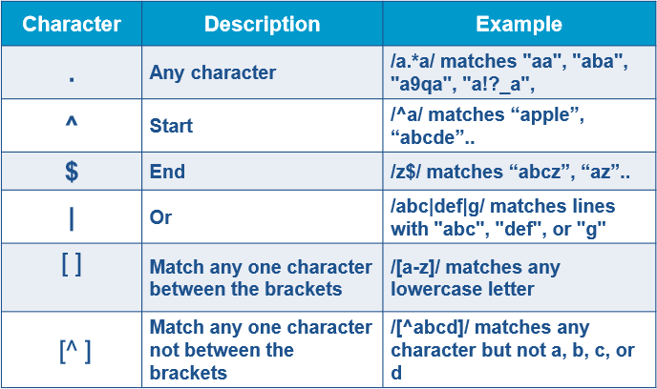
RegExp Syntax

Slide 32
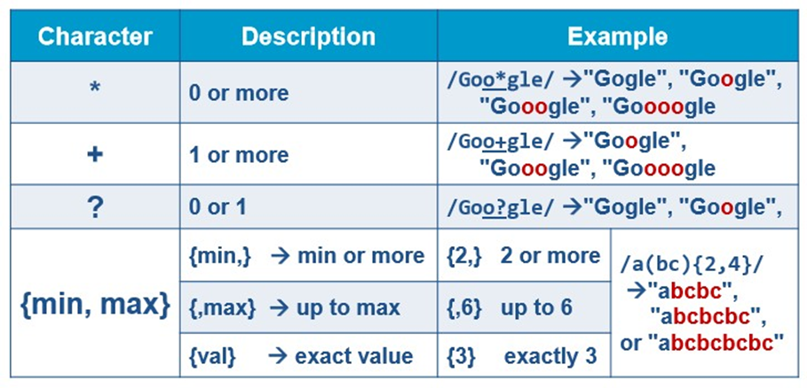
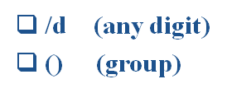
RegExp Syntax

Slide 33
Array object is a global object that is used in the construction of arrays.
Array

Slide 34
Array Object
Array is a special type of object
It has length property:
gives the length of the array It is one more than the highest index in the array
Declaring an array
var myarr=[]; //declaring an array literal
var myarr=[1 , 2 , ‘three’ , ’four’ , false];
var myarr= new Array() //using array constructor.
var myarr=new Array(2) //an array with 2 undefined elements
var myarr=new Array(1,2,’r’,true); //an array with 4 elements
Notes:
var colorArray = new Array(); colorArray [0]=“red”; colorArray [1]=“blue”; colorArray [2]=“green;
//OR
var colorArray = new Array(3); colorArray [0]=“red”; colorArray [1]=“blue”; colorArray [2]=“green”;
//OR
var colorArray = new Array(“red”,”blue”,”green”);
//OR
var colorArray=[];
var colorArray=[“red”,”blue”,”green”];

Slide 35
Array Methods
var arr = new Array(“A”,”B”,”C”);
var arr2 = new Array(“1”,”2”,”0”)
Method | Description | Example
pop() | Removes and returns the last element of an array. | arr.pop() //C, and the length becomes 2
push() | Adds elements to the end of an array. | arr.push(“D”) //4 (Length of the array) //and arr[3]=“D”
shift() | Removes and returns the first element of an array. | arr.shift() // A //arr[0] =“B” & arr[1]=“C”
unshift() | Adds elements to the beginning of an array. | arr.unshift(“D”)); //4 //arr[0]=“D”
toString() | Returns a string representation of the array. | arr2.toString()//1,2,0

Slide 36
Array Methods
Method | Description | Example
concat() | Concatenates elements from one array to another array. | arr.concat(arr2) //A,B,C,1,2,0
join() | Joins the elements of an array by a separator to form a string. | arr.join()//A,B,C arr.join(“*”)//A*B*C
reverse() | Reverses the order of the elements in an array. | arr.reverse() //C,B,A
slice([begin[, end]]) | Creates a new array from elements of an existing array. | arr.slice(1) // B,C arr.slice(2) //C
sort() | Sorts an array alphabetically or numerically. | arr2.sort() //1,10,2
Splice(start[, deleteCount[, item1[, item2[, ...]]]]) | Removes and/or replaces elements of an array. | arr.slice(1) // B,C arr.slice(2) //C

Slide 37
Array Object
Associative Arrays: The Arrays That Aren't
Associative arrays provide let you specify key-value pairs.
Associative array is just like an ordinary array, except that instead of the indices being numbers, they’re strings, which can be a lot easier to remember and reference:
Although the keys for an associative array have to be strings, the values can be of any data type, including other arrays or associative arrays.
Syntax:
<script>
var assocArray = new Array( );
assocArray[“Ahmed"] = “Excellent"; assocArray[“Tareq"] = “pass";
</script>

Slide 38
Every JavaScript function is actually a Function object.
Function

Slide 39
User-defined functions
Function blocks begin with the keyword function followed by the function name and () then {} its building block declaration.
Syntax:
function functionName (argument1, argument2, ...)
{
//statement(s) here
//return statement;
}
return can be used anywhere in the function to stop the function’s work. Its better placed at the end.

Slide 40
Defining function
function myFunction(x,l)
{
var y = x+l;
return y;
}
Functions
Calling function
var z = myFunction(5,6)
Notes:
Function Types
Function Statement
Function Expresions
Arguments Array & this argements
This is the caller else if use (apply or call)

Slide 41
Error Handling
try
catch
Debugger
throw

Slide 42
Error Object
Whenever an error occurs, an instance of the Error object is created to describe the error.
Error objects can be created in 2 ways:
Explicitly:
var ErrorObj = new Error();
Implicitly:
thrown using the throw statement.

Slide 43
Error Object
Property | Description
description | Plain-language description of error
fileName | URI of the file containing the script throwing the error
lineNumber | Source code line number of error
message | Plain-language description of error (ECMA)
name | Error type (ECMA)
number | Microsoft proprietary error number

Slide 44
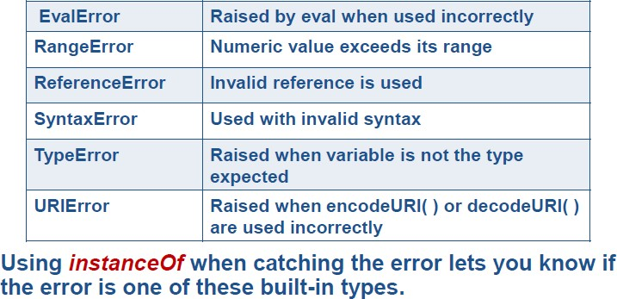
Error Object
Six additional Error constructor ones exist and they all inherit Error:

Slide 45
Error Object
Error Object standard Properties:
Name: The name of the error constructor used to create the object
Example:
var e = new Error('Oops');
Message: Additional error information
Example:
var e = new EvalError('jaavcsritp is _not_ how you spell it'); document.write(e.name); //EvalError
document.write(e.message); // jaavcsritp is _not_ how you spell it

Slide 46
Try … Catch
The try...catch statement allows you to test a block of code for errors.
The try block contains the code to be run.
The catch block contains the code to be executed if an error occurs.
Syntax:
try
{
//Run some code here
}
catch(err)
{
Implicitly Created Error object “err”
//Handle errors here
}

Slide 47
Try … Catch
If you have any functionality that needs to be processed regardless of success or failure, you can include this in the finally block (will executed even if there break, throw, or return statements in catch block.
try{
//Run some code here
}
catch(err)
{
//Handle errors here
}
finally
{
//Here code that will be executed on both cases
}

Slide 48
Try … Catch (throw)
The throw statement allows you to create an exception.
Using throw statement with the try...catch, you can control program flow and generate accurate error messages.
Syntax:
throw(exception)
The exception can be a string, integer, Boolean or an object.

Slide 49
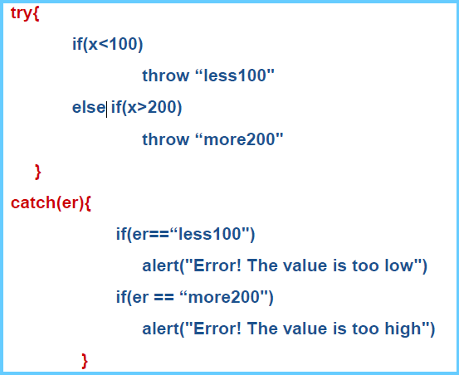
Try … Catch

Slide 50
Events
Events are actions that respond to user’s specific actions.
HTML creates the visual image of controls, but they are mute.
JavaScript animates it all and makes the page interactive through events, like a button press, a mouse hover, a text changed, a link pressed……etc.
Every HTML element has several events attached to it. These events need event handlers.
Event handler is JavaScript code that is executed when an event is triggered
Notes:
Events are controlled in JavaScript using event handlers that indicate what actions the browser takes in response to an event.
Event handlers are created as attributes added to the HTML tags in which the event is triggered.
An Event handler adopts the event name and appends the word “on” in front of it.
< tag onEvent = “JavaScript commands;”>
Thus the “click” event becomes the onClick event handler

Slide 51
Events
Events can be attached to JavaScript code through one of the following ways (Binding Event Handlers to Elements can be):
Inline HTML Attributes
Element Properties
DOM Event Listeners (will be discussed later)
You can attach only one function to the event.

Slide 52
Binding Event Handlers to Elements
1. Event handlers as tag attribute:
<input type=button value=“click me” name='b1‘ onclick=“alert(‘you have made a click’)”>
OR
<script>
function showmsg()
{
alert(“you have made a click”)
}
</script>
<input type=button value=“click me” onclick=“showmsg()” />

Slide 53
Types of Events
Mouse events
mouseup, mousedown, click, dblclick, mouseover, mouseout, mousemove, dragstart
Keyboard events
keydown, keypress, keyup.
Loading/window events
load, unload, beforeunload, abort, error, resize, scroll, contextmenu, blur, focus, change.
Form events
change, select, reset, submit.
Notes:
onAbort The User interrupted the transfer of an image
onBlur when loosing focus
onFocus when setting focus
onChange when the element has lost the focus and the content of the element has changed
onLoad a document or other external element has completed downloading all the data into the browser
onUnload a document is about to be unloaded from the window
onError When an error has occurred in a script.
onMove when moving the browser window
OnReset When the user clicks the form reset button
onSubmit When the user clicks the form submit button
onScroll When the user adjusts an element’s scrollbar
onResize When the user resizes a browser window
onHelp When the user presses the F1 key
onselect When selecting text in an input or a textarea element
onStart When A marquee element loop begins
onFinish When a marquee object finishes looping
onSelectStart When the user is beginning to select an element

Slide 54
Event Object
The event object is passed implicit to the event handling function as an argument
Always keep in mind that HTML is for content, JavaScript for behavior and CSS for formatting, and you should keep these three SEPARATE as much as possible.
Let’s explore Event Object Properties !!!

Slide 55
Event Object
Event handlers return value:
<a href=“#” onclick=“myFunc();return false”> click me </a>
This will make the browser ignore the action of href
Another way that can also make the browser ignore the action of href is:
<a href="javascript: void(0)" onclick="alert('hi')" >click me</a>

Slide 56
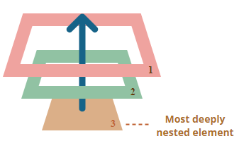
Bubbling
When an event happens on an element, it first runs the handlers on it, then on its parent, then all the way up on other ancestors.
any handler may decide that the event has been fully processed and stop the bubbling.
The method for it is event.stopPropagation().

Slide 57
This object
Use this keyword to refer to the current object.
Self reference to the object is used :
<input type=“text” onFocus = "this.value=‘You are in!’“/>
Passing current Object as a function parameter:
function myFunction(myObject)
{
myObject.value = ”In the function!!“
}
<input type=“text” onClick=“myFunction(this)”/>

